Slide 1
Validation framework for Python-based steady-state wake modeling software
Rafael Mudafort, WESC 2023
The Alliance for Sustainable Energy, LLC (Alliance) is the manager and operator of the National Renewable Energy Laboratory (NREL). NREL is a national laboratory of the U.S. Department of Energy, Office of Energy Efficiency and Renewable Energy. This work was authored by the Alliance and supported by the U.S. Department of Energy under Contract No. DE-AC36-08GO28308. Funding was provided by the U.S. Department of Energy Office of Energy Efficiency and Renewable Energy, Wind Energy Technologies Office. The views expressed in the article do not necessarily represent the views of the U.S. Department of Energy or the U.S. government. The U.S. government retains, and the publisher, by accepting the article for publication, acknowledges that the U.S. government retains a nonexclusive, paid-up, irrevocable, worldwide license to publish or reproduce the published form of this work, or allow others to do so, for U.S. government purposes.

Slide 2
Analytical Wake Models
“DNV believes that successful design and implementation of wind farm control relies on the accuracy of analytical techniques and models, and on their validation against experimental data. Since every model comes with some degree of approximation, DNV considers the quantification of uncertainty in the analytical predictions to be a key step on the route to bankability of wind farm control.”
Wind farm control: The route to bankability
DNV position paper, 2021
https://www.dnv.com/Publications/wind-farm-control-198162

Slide 3


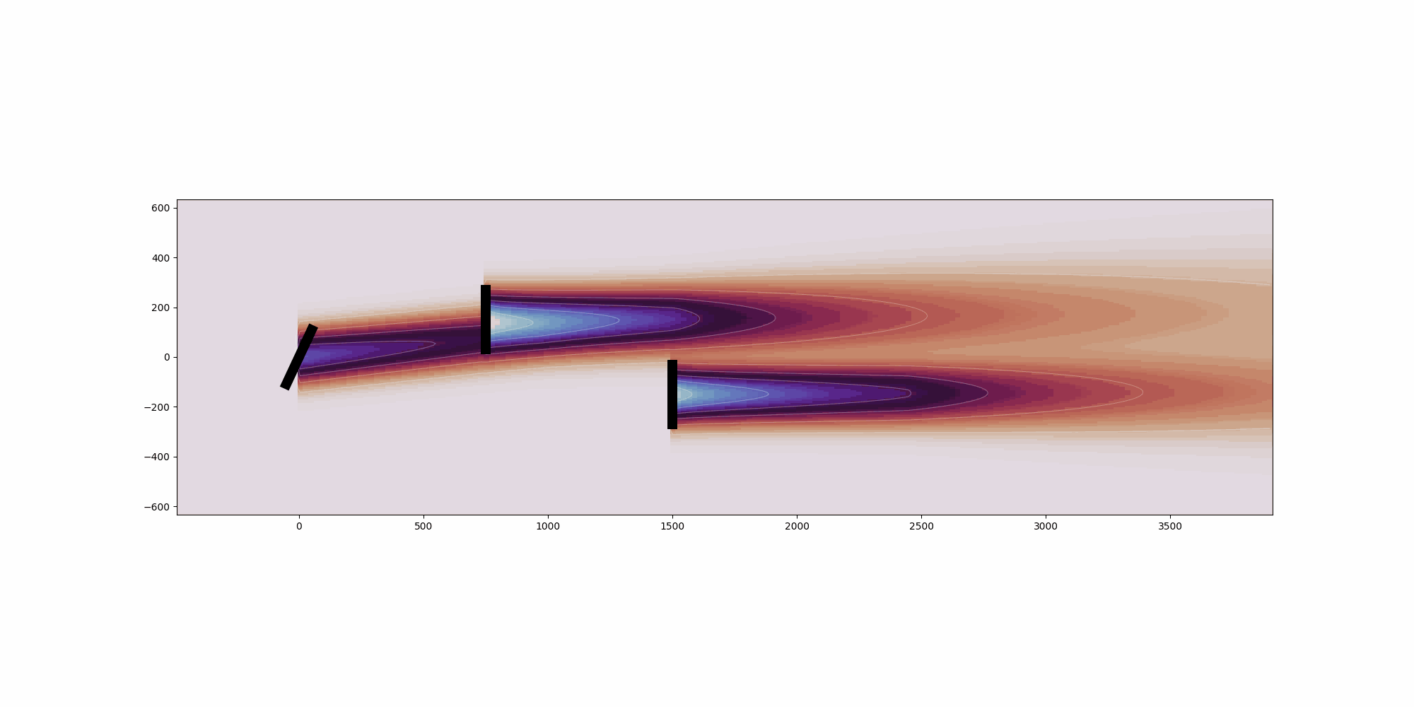
Analytical Wake Models
Carbajo Fuertes
TurbOPark IX
Niayifar /
Porte-Agel
GCL
Fuga
Jensen
Zong
Bastankah
TurbOPark
FLORIS
Cumulative Curl
Gauss-Curl Hybrid
Empirical gauss

Slide 4
Code-Code Validation Framework
Provides the infrastructure for codes to plug in to the framework
Common data
Input: windIO
Output: common data structure extracts relevant data from wake modeling codes
Plotting and results analysis tools are provided

Slide 5
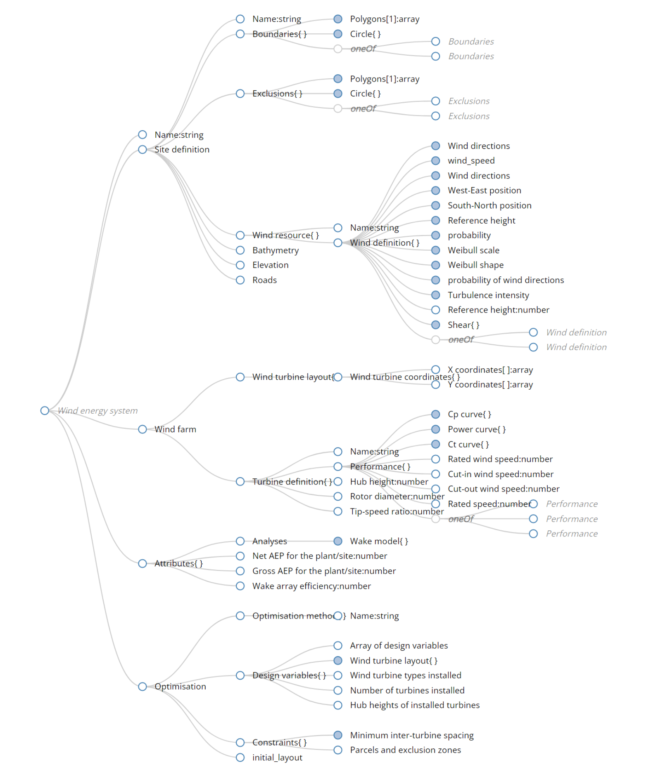
Task 37 Ontology - windIO
A standard text-based input file representation of a wind plant.
Namestring: the name of the plant
Site definition: physical definition of the plant boundaries, terrain, and wind resource
Wind farm: description of the turbines in the plant and their layout
Attributes: computed values of energy production and wake models to be used
Optimization: formulation of plant layout and design optimization problem.
Bortolotti, Pietro, Bay, Christopher, Barter, Garrett, Gaertner, Evan, Dykes, Katherine, McWilliam, Michael, Friis-Moller, Mikkel, Molgaard Pedersen, Mads, & Zahle, Frederik. System Modeling Frameworks for Wind Turbines and Plants: Review and Requirements Specifications. United States. https://doi.org/10.2172/1868328

Slide 6
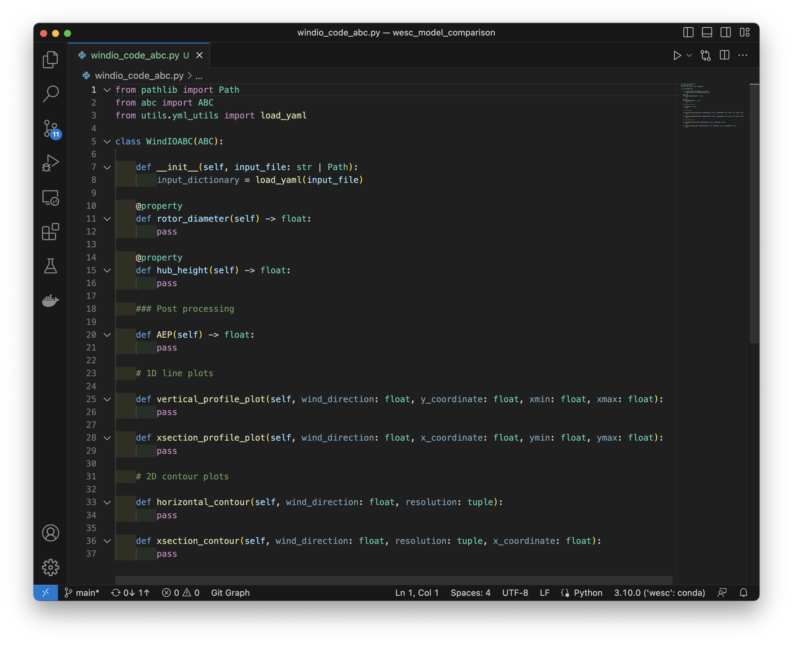
API Overview
Init simulation from windIO
Calculate AEP
Convert to common data structure and create plots

Slide 7
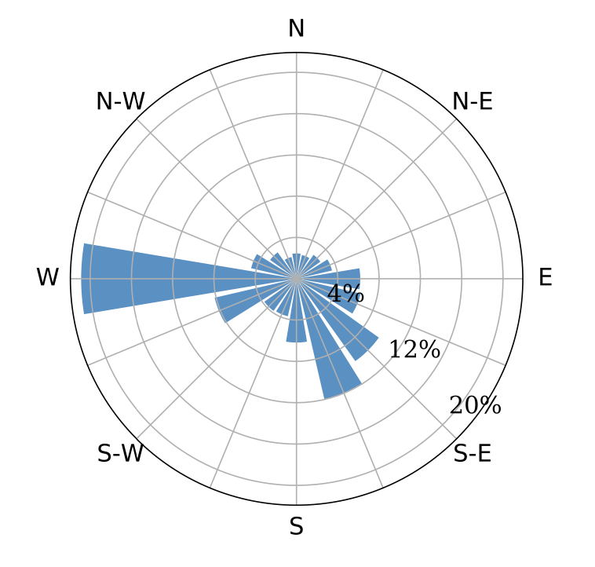
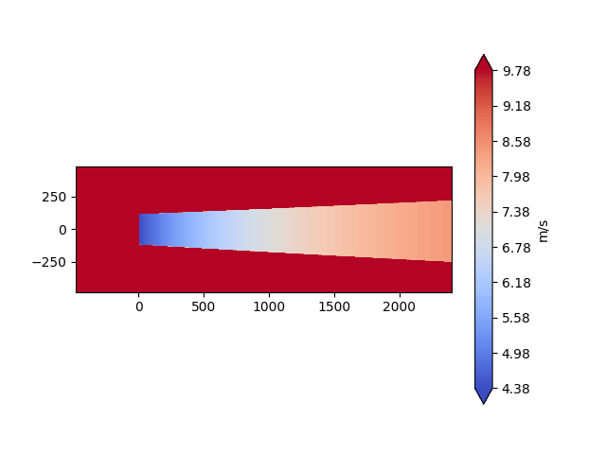
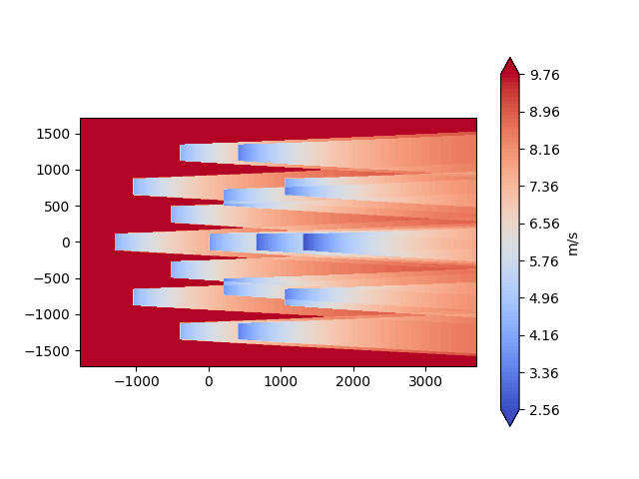
Compare Cases – Jensen Model
1 turbine
1 wind condition
IEA Wind Task 37 Optimization Case Study 1
Baker N, Stanley A P, Thomas J, Ning A and Dykes K 2019 Best practices for wake model and optimization algorithm selection in wind farm layout optimization AIAA SciTech 2019 (San Diego, California, USA)

Slide 8
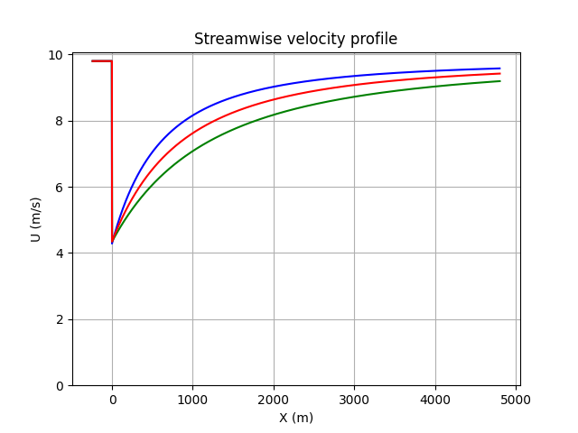
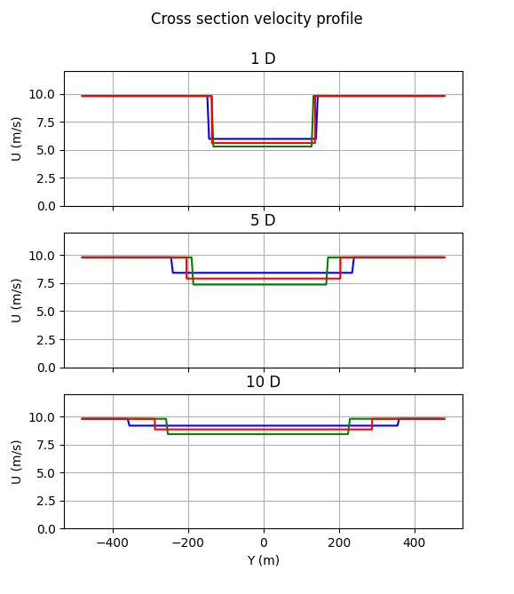
1 Turbine Wake Profile
WindIOSim.streamwise_profile_plot()
WindIOSim.xsection_profile_plot()

Slide 9
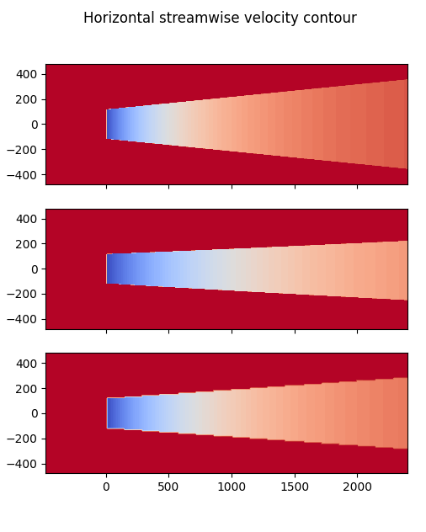
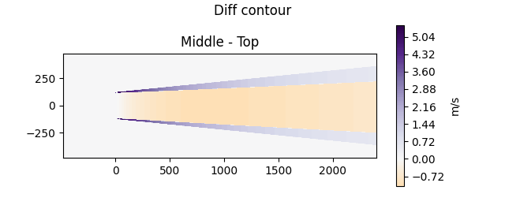
1 Turbine Wake Shape
WindIOSim.horizontal_contour()
A little more complicated…

Slide 10
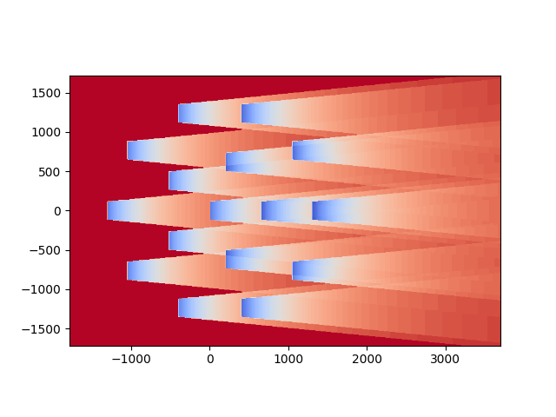
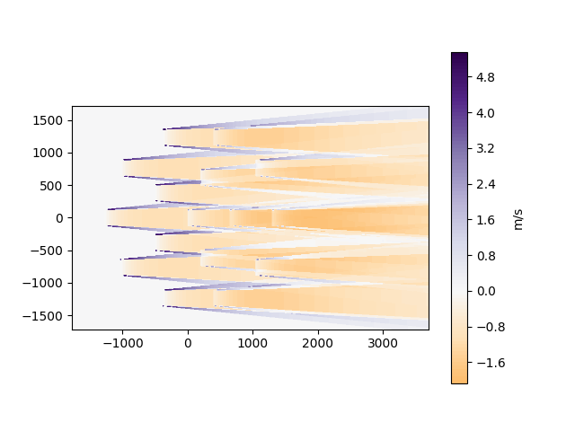
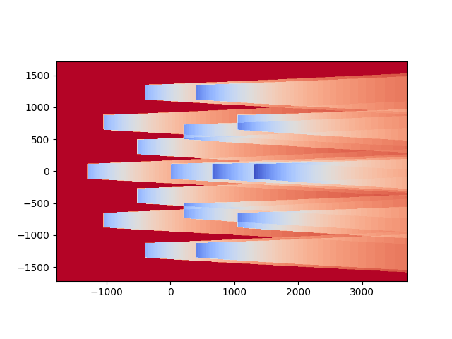
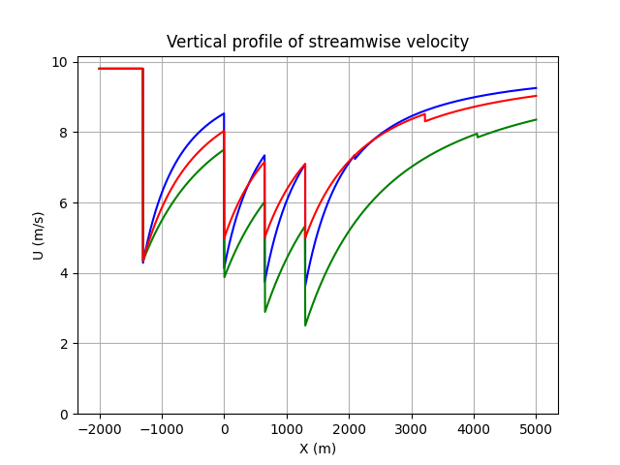
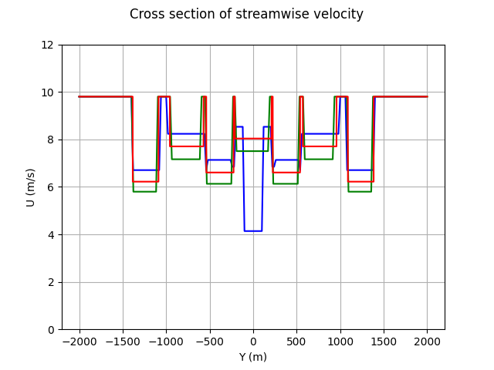
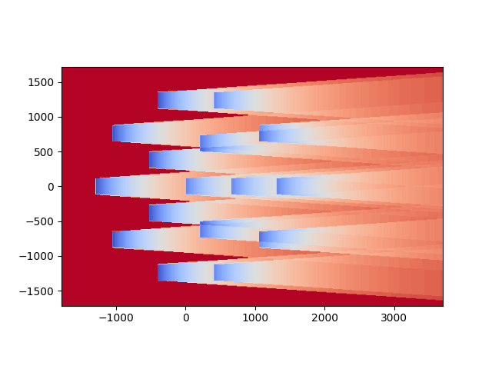
Change Input: Task 37 Case Study 1
Two changes to the script:
Path to the input file
Extend of the 1D plots
Middle - Top
Section at y=0
Section at x=0

Slide 11
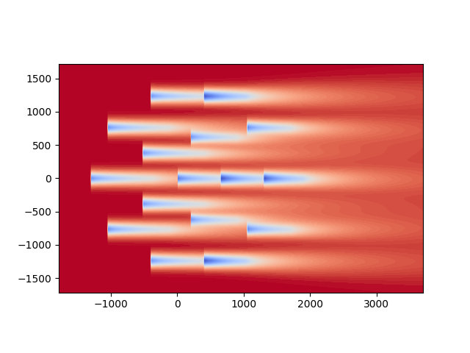
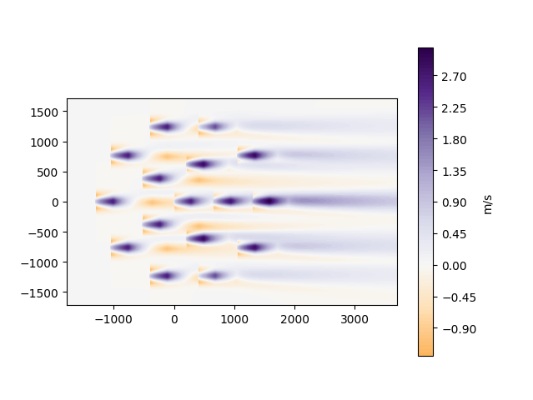
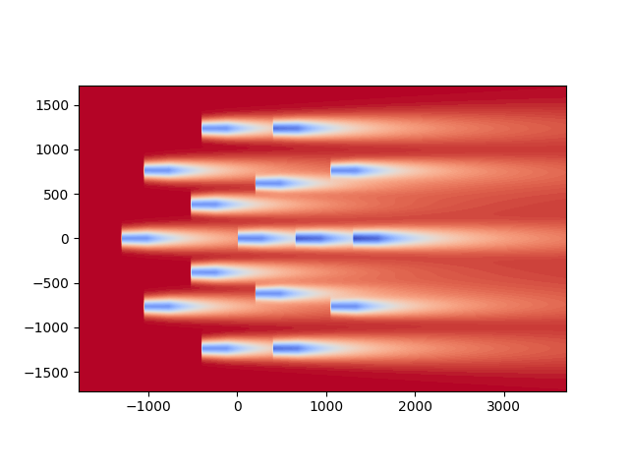
Bastankah Model, 16 T
One change from the previous script:
Path to the input file

Slide 12
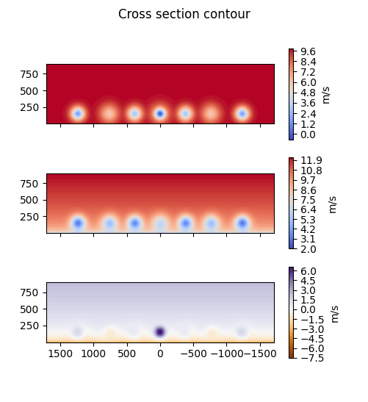
Summary and Conclusions
Write analysis code once to evaluate multiple codes and wake models
No analysis in this work here, but this is a clear opportunity for collaboration across institutions
Complements the recent proposal in IEA Task 44 to classify wake modeling tools
Potential for reference validation cases

Slide 13
Thank you! Rafael.Mudafort@nrel.gov

